Slide 1

HVTN 703/HPTN 081 Protocol Overview
Presented by
Sri Edupuganti, MD MPH
Emory University Hope Clinic CRS, Atlanta, Georgia
November 10, 2015

Slide 2
Outline of this Presentation
VRC01 monoclonal antibody
AMP Trial Design considerations
Study Population/cohorts
Selection of sample size
PrEP in the Americas
Selection of dose and schedule of VRC01
Trial Monitoring
Eligibility criteria
Operational aspects – infusion visits (RPI)

Slide 3
PROTOCOL
HVTN 703 / HPTN 081
A phase 2b study to evaluate the efficacy of VRC01 broadly neutralizing monoclonal antibody in reducing acquisition of HIV-1 infection

Slide 4
HVTN 703/HPTN 081, The AMP Study: Defining a new path forward
AMP = Antibody Mediated Prevention
This is the first trial to assess if antibodies can be used to prevent HIV infection (similar to how antibodies prevent other diseases).

Slide 5
There is a long history of using
antibodies to prevent viral infections.
VIRUS | PRODUCT DESCRIPTION | INDICATION
Measles | Concentrated human gamma globulin | Prevention
Polio | Concentrated human gamma globulin | Prevention
CMV | Cytomegalovirus Immune Globulin | Prevention
Hepatitis A | Immune serum globulin (ISG) | Prevention (travel)
Hepatitis B | Hepatitis B Immune Globulin | Post Exposure
Rabies | Rabies Immune Globulin | Post Exposure
RSV | mAb (palivizumab) for prophylaxis of high risk infants | Prevention in High Risk Infants
VZ | Varicella Zoster Immune Globulin | Post Exposure
And, most effective vaccines induce antibodies that neutralize the pathogen.
Thanks to John Mascola for this slide.

Slide 6
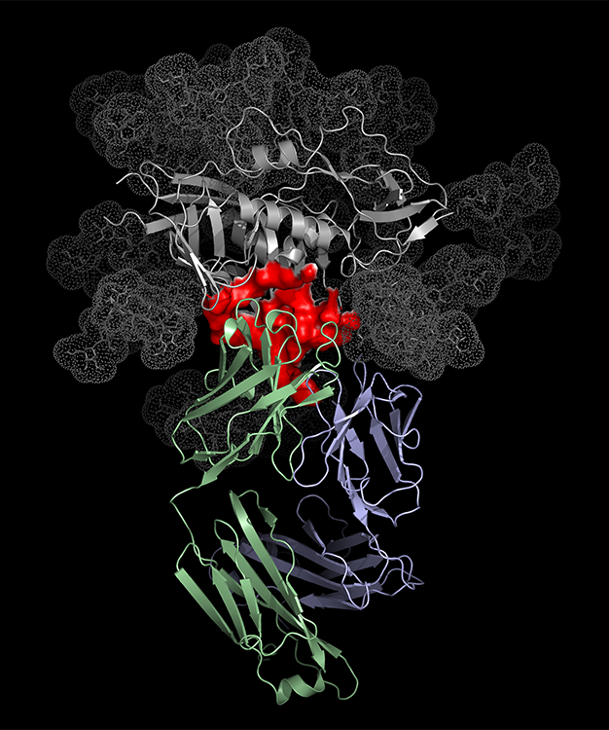
VRC01: Antibody being tested in the AMP Study to prevent acquisition of HIV infection
Discovered in an individual who was HIV infected for a long time (>15 years), who maintained virologic control on no ART
Developed by John Mascola & colleagues at the Vaccine Research Center of the National Institutes of Health
Gray: gp120
Red: CD4 binding site (CD4bs)
Purple & Green: VRC01 attached to the CD4bs
Photo: NIAID/NIH Vaccine Research Center (VRC)

Slide 7
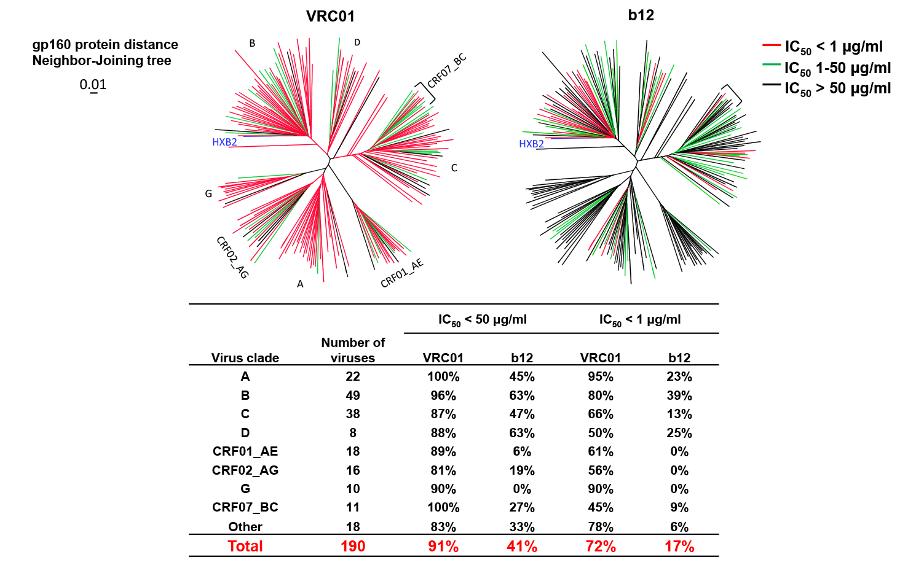
VRC01 is Broadly Neutralizing
Thanks to Barney Graham and
Wu et al. Rational design of
envelope identifies broadly
neutralizing human monoclonal
Antibodies to HIV. Science. 2010
Panel of 190 Diverse Viral Isolates
Notes:
Top portion : VRC01 neutralizes HIV isolates from many different clades at a 50% inhibitory concentration of < 1mcg/ml compared to another antibody b12 which is much less neutralizing.
Bottom portion: VRC 01 neutralized 91% of HIV isolates at an if IC 50 of <50mcg/ml and 72% of isolates at IC50 of < 1mcg/ml.
Geometric mean IC50 from all HIV isolates from all clades tested is .33mcg/ml

Slide 8
VRC01 is a Potent Antibody
Thanks to David Montefiori & CAVD and Bob Bailer & NVITAL Laboratory

Slide 9
VRC01: Safety and Tolerability
Studied in Phase 1 trials: VRC601, VRC602, HVTN104
VRC 601 : dose escalation and PK study of IV and SC in HIV infected individuals
VRC 602: dose escalation and PK study of IV and SC in HIV uninfected individuals
HVTN 104: safety and PK study of VRC01 in HIV uninfected individuals
Overall, safe and well-tolerated

Slide 10
Trial Design Rationale for HVTN 703/HPTN 081
Passive administration of VRC01 antibody will reduce acquisition of HIV infection in high risk populations;
Doses selected will determine the activity of the antibody across a range of serum concentration in diverse populations across multiple geographic regions of the world;
Level of VRC01 antibody required for protection will vary by type of sexual exposure and not by clade;
Concentration of antibody in serum will be directly associated with the rate of protection; that is, higher levels of antibody will give greater rates of protection than lower levels; and
Breakthrough isolates will have greater resistance to neutralization and will exhibit molecular signatures associated with escape from neutralization.

Slide 11
The AMP Study: Objectives & Endpoints
Safety & Tolerability of VRC01 infusion
Reactogenicity, AEs, SAEs, discontinuation rates
Efficacy to prevent HIV infection
HIV infection by week 80 in those HIV-negative at enrollment
Develop a marker(s) of VRC01 that correlates with the level and antigenic specificity of efficacy
Serum VRC01 concentration
Serum mAb effector functions
Breakthrough HIV viral sequences in infected people
VRC01 neutralization sensitivity of, & effector functions against, HIV strains from infected trial participants
PRIMARY
SECONDARY

Slide 12
Design considerations for the AMP Trial
How long to follow participants for HIV infection?
How to ensure adequate variability in mAb characteristics over time and/or among mAb recipients to enable correlates assessment?
What dose? What schedule? Assign to multiple doses or schedules? How frequently to test for HIV?
How to factor background prevention measures such as PrEP into the sample size calculations?
How to sample markers to allow accurate modeling of mAb characteristics over time?
(mAb= monoclonal antibody)

Slide 13
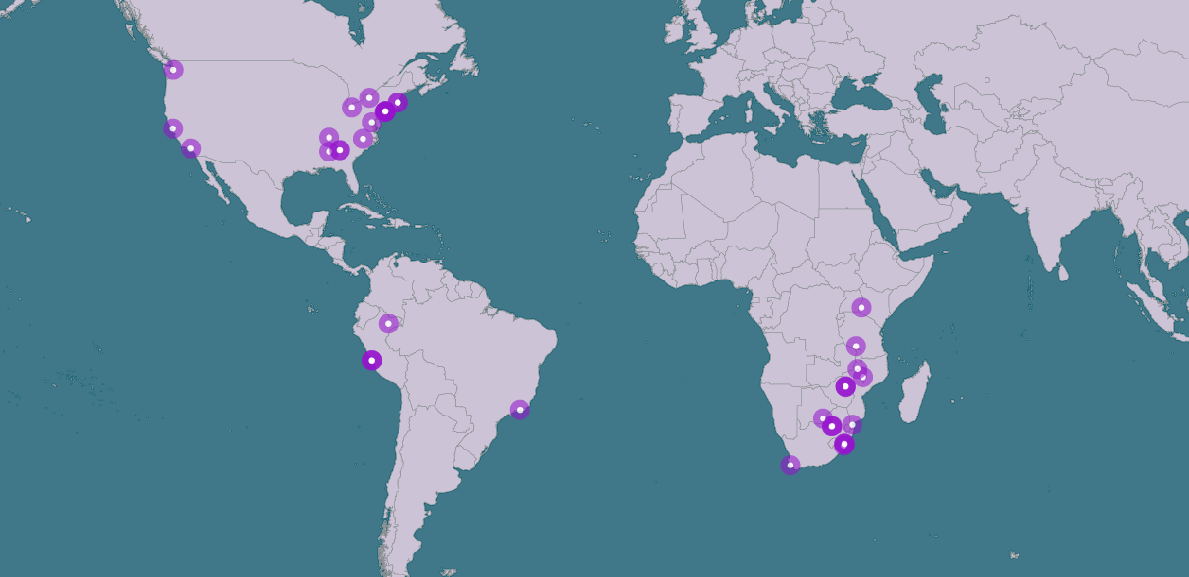
AMP Study Research Sites (As of October, 2015)
Notes:
Many research sites in the US, South America, and Africa that will be involved in The AMP Study.
19 sites in the US; 5 sites in South America; total 24 sites in the Americas
16 sites in southern Africa
Total of 40 study sites

Slide 14
HVTN 703/HPTN 081 Trial Sites in the Americas
United States
South America
Atlanta, GA (2 clinic locations)
Birmingham, AL
Boston, MA (2 clinic locations)
Chapel Hill, NC
Cleveland, OH
Los Angeles, CA
Nashville, TN
Newark, NJ
New York City, NY (4 clinic locations)
Philadelphia, PA
Rochester, NY
San Francisco, CA
Seattle, WA
Washington, DC
Peru
Lima (3 CRSs)
Barranco, San Miguel, Via Libre
Iquitos
Association Civil Selva Amazonica
Brazil
Rio de Janeiro– IPEC-Fiocruz

Slide 15
Cohorts for the AMP Study
Cohort | Antibody (VRC 01) 10mg/kg | Antibody (VRC 01) 30mg/kg | Placebo | Total Population
Americas: United States, Peru & Brazil MSM & TG people (Clade B) | 800 | 800 | 800 | 2,400
Southern Africa: South Africa, Botswana, Zimbabwe, Kenya, Malawi, Mozambique, Tanzania Heterosexual women (Clade C) | 500 | 500 | 500 | 1,500
Total | 1,300 | 1,300 | 1,300 | 3,900
Notes:
The 2 major cohorts were selected to represent people who are at high risk of HIV infection.

Slide 16
Assumptions for Sample Size Calculations
Incidence
3% annual HIV-1 incidence in the North/South American MSM & TG placebo group against an assumed back ground PrEP use
5.5% annual HIV-1 incidence in the sub-Saharan African women placebo group
30 month uniform accrual with halved accrual during the first three months
Q4-weekly visits for HIV-1 diagnostic tests
10% annual dropout incidence in each of the three study groups
For each of the antibody treatment groups, average treatment efficacy versus placebo within an 8-week infusion interval is assumed to be the same for each of the 10 infusion intervals
Notes:
Retention rate of 90%

Slide 17
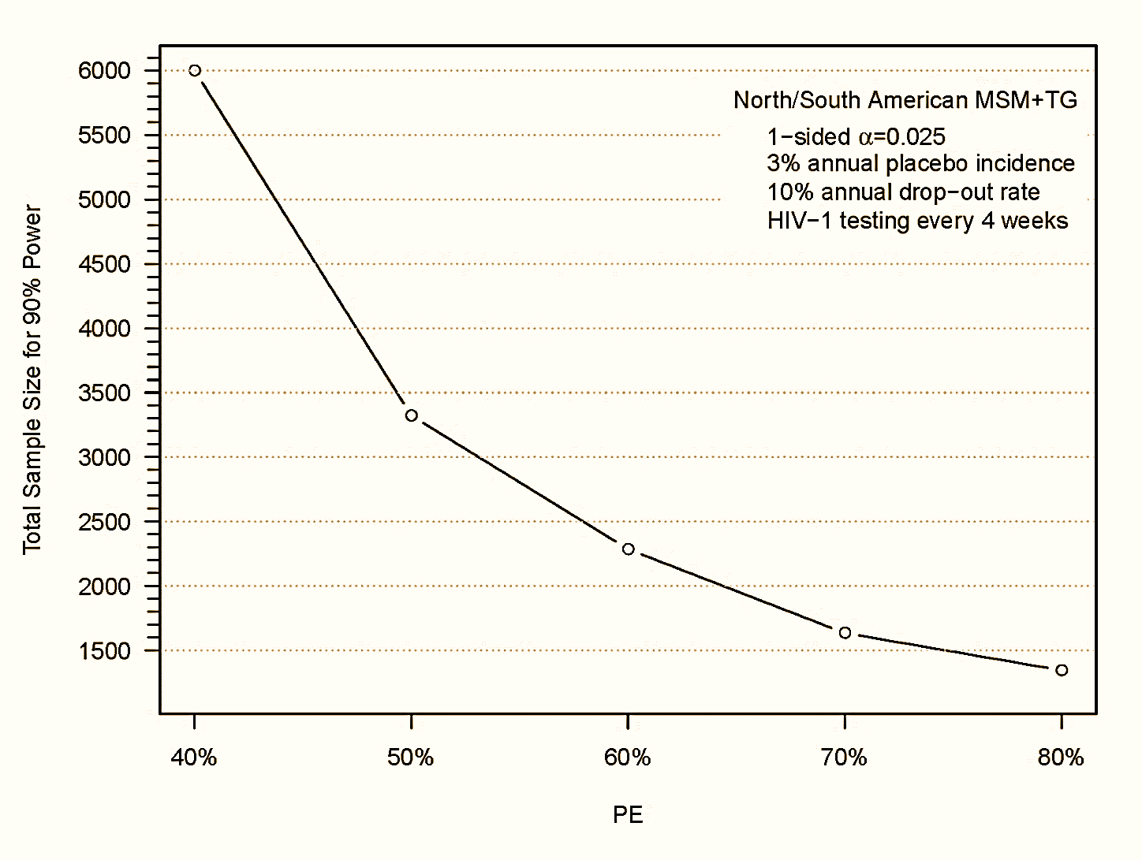
Sample size selection for MSM/TG Cohort in the Americas
(Prevention Efficacy)

Slide 18
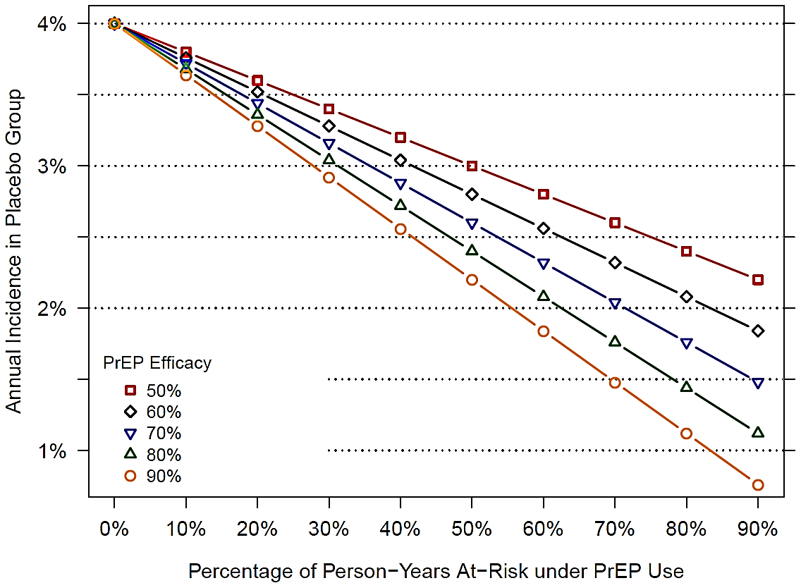
Annual HIV-1 incidence in the North/South American MSM + TG Placebo group (as a function of PrEP use and efficacy)

Slide 19
PrEP in the AMP study - United States
PrEP in MSM works!
United States
FDA approved Truvada® (emtricitabine/tenofovir) in July, 2012 for use as PrEP
CDC guidelines recommend daily use of Truvada® in high risk MSM
Participants in the AMP study will have access to free Truvada®
Donated by Gilead Sciences, Inc.
Truvada® will be stored at a centralized mail order pharmacy

Slide 20
PrEP in the AMP Study - South America
Peru – 4 CRSs
Currently PrEP is available through Demonstration Projects
Truvada® not licensed for PrEP use
Licensure application has been initiated
Brazil – 1 CRS
Demonstration Projects
Licensure application for Truvada®/PrEP is in progress

Slide 21
The AMP Study — Trial Design Outline of this Presentation
VRC01 monoclonal antibody
Design considerations
Study Population/cohorts
Selection of sample size
PrEP in the Americas
Selection of dose and schedule of VRC01
Trial Monitoring
Eligibility criteria
Operational aspects – infusion visits (RPI)

Slide 22


VRC01 antibody dosing in the AMP study – an efficacy trial
REGIMEN | MSM & TG in the Americas | Women in sub-Saharan Africa | TOTAL
VRC01 10 mg/kg | 800 | 500 | 1300 | 10 infusions total & Infusions every 8 weeks Study duration: ~22 months
VRC01 30 mg/kg | 800 | 500 | 1300
Control (normal saline) | 800 | 500 | 1300
Total | 2400 | 1500 | 3900

Slide 23
Study Schema for HVTN 703/HPTN 081
 |  |  |  | INFUSION SCHEDULE (WEEKS)
 | Cohort | Treatment | N | 0 | 8 | 16 | 24 | 32 | 40 | 48 | 56 | 64 | 72 | 80 | 92
Group 1 | North + South American MSM & TG | VRC01 10 mg/kg | 800 | A | A | A | A | A | A | A | A | A | A
Group 2 |  | VRC01 30 mg/kg | 800 | A | A | A | A | A | A | A | A | A | A
Group 3 |  | Control | 800 | C | C | C | C | C | C | C | C | C | C
Group 4 | sub-Saharan African women | VRC01 10 mg/kg | 500 | A | A | A | A | A | A | A | A | A | A
Group 5 |  | VRC01 30 mg/kg | 500 | A | A | A | A | A | A | A | A | A | A
Group 6 |  | Control | 500 | C | C | C | C | C | C | C | C | C | C
 | Total | 3900 (1300 VRC01 30 mg/kg; 1300 VRC01 10 mg/kg; 1300 control)
Week 80: Post-infusion visit to evaluate efficacy
Week 92: Final study visit, evaluate safety and tolerability
[A = VRC01 infusion; C = Control infusion]

Slide 24
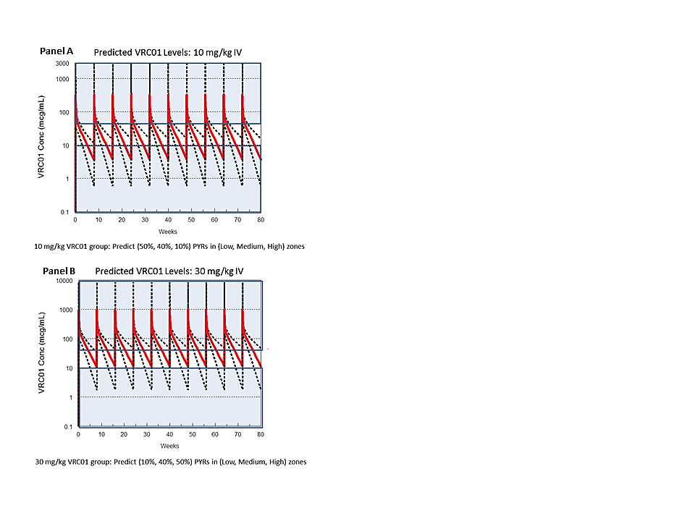
Predicted VRC01 serum concentrations at 2 doses (10mg/kg and 30mg/kg)
>50 mcg/mL
10-50 mcg/mL
<10 mcg/mL
>50 mcg/mL
10-50 mcg/mL
<10 mcg/mL
Notes:
Figure 2‑4 Predicted VRC01 serum concentrations over time.
Panel A: Predicted VRC01 median serum concentration over time (solid lines) for 10 mg/kg IV infusions of VRC01 at Weeks 0, 8, 16, 24, 32, 40, 48, 56, 64, 72, with 95% confidence intervals (CI) (dashed lines). The shaded regions classify the serum concentration into high, medium, and low ranges based on the cut-points 10 and 50 mcg/mL.
Panel B: Predicted median VRC01 serum concentration over time for 30 mg/kg IV infusions of VRC01 at Weeks 0, 8, 16, 24, 32, 40, 48, 56, 64, 72. The shaded regions classify the serum concentration marker S(t) into high, medium, and low ranges based on the cut-points 10 and 50 mcg/mL. PYR = person-year at risk.
Based on in vitro neutralization studies and NHP challenge studies, the expected trough levels of VRC01 are projected to be an order of magnitude higher than levels required to protect against majority of circulating of HIV 1 strains.

Slide 25
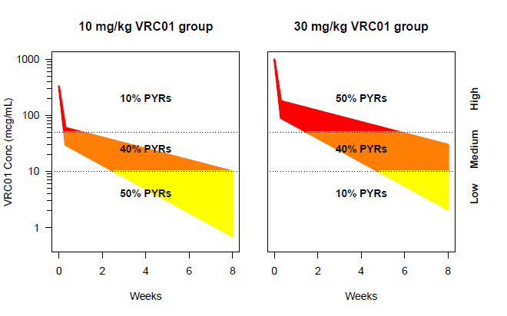
Two Dose Groups: Overlapping Serum Concentrations
10 and 30 mg/kg VRC01
Group Overlap
1000
10% PYRs
>50 mcg/mL
10-50 mcg/mL
<10 mcg/mL
Low
100
VRC01 Conc (mcg/mL)
Medium
10
10% PYRs
High
1
0
2
Weeks
4
6
8
 | 10 mg/kg | 30 mg/kg | Overlap
High (>50 mcg/mL) | 10% PYRs | 50% PYRs | 10% PYRs
Medium (10 to 50 mcg/mL) | 40% PYRs | 40% PYRs | 40% PYRs
Low (<10 mcg/mL) | 50% PYRs | 10% PYRs | 10% PYRs
Total Overlap = 60% PYRs or Person Years at Risk
Notes:
Purple – 30mg/kg group
Green – 10mg/kg group

Slide 26
VRC01 antibody dose and schedule
A challenging aspect of dose/schedule selection for the AMP Study is that the serum level of VRC 01 required to protect against HIV infection in humans is unknown

Slide 27
AMP Trial Monitoring
Early feasibility check
After ~240 participants (~25% of participants) have completed week 32 visit, infusion feasibility will be conducted and reported to DSMB
80% or more of 240 participants need to remain engaged in the trial
Monitoring for harm, non-efficacy, high efficacy
Monitoring for operational futility

Slide 28
Outline of this Presentation
VRC01 monoclonal antibody
AMP Trial Design considerations
Study Population/cohorts
Selection of sample size
PrEP in the Americas
Selection of dose and schedule of VRC01
Trial Monitoring
Eligibility criteria
Operational aspects – infusion visits (RPI)

Slide 29
The AMP Study: Select Eligibility Criteria
18-50 years of age
HIV uninfected
Risk behavior related criteria:
In the Americas: male or TG who has had condomless anal intercourse with ≥ 1 male or TG partner or any anal intercourse with ≥ 2 male or TG partners in the past 6 months
In Africa: female who has had vaginal or anal intercourse with a male partner in the past 6 months
All volunteers in a monogamous relationship with an HIV(-) partner for > 1 year are excluded.
Consistent use of effective contraception
Volunteers with clinically significant medical conditions are excluded

Slide 30
Study Related Procedures for AMP Participants
IV: receive an IV over a 30-60 minute period every 8 weeks (10 times total)
Blood draw: undergo a blood draw at the clinic every 4 weeks (includes an HIV test)
STI testing: undergo STI testing (urine & rectal or cervicovaginal swabs) about every 6 months
Questionnaires: complete questionnaires about sexual behavior & general health every 4-8 weeks
STUDY DURATION: about 22 months

Slide 31

Trial Design Aspects for Clinic Consideration
Intravenous infusion, 30-60 minutes
Monthly visits (infusions every 8 weeks)
Medical emergency management capacity
CASI administration
Study participant populations

Slide 32
Infusion visits
HVTN 104/Phase I Study
All 6 CRSs reported:
Infusions Visits = 4.5-5 hours
Could only comfortably complete 1 infusion/day
TOTAL HVTN 104 infusions = 276
HVTN 703/HPTN 081 Phase 2b study
40 clinical sites
3,900 participants x 10 infusion visits = 39,000 infusions
4 to 5 hrs/infusion
= poor enrollment and retention
= too much $$$
not feasible
Notes:
In HVTN 104/phase I study, each infusion visit was taking 4.5 hours; not feasible for a phase 2b study.

Slide 33
Lean Principles and Rapid Process Improvement (RPI)
Collaboration between HVTN and HPTN
Management Guidance Team consisting of 14 members: representatives from AMP Team leadership, SDMC, Lab, VRC, and DAIDS MOs/PAB/OCSO
Finalize a project charter
Agree on an effective program
A work shop was conducted with a RPI team consisting of 22 members: site clinicians, pharmacists, representatives from DAIDS OCSO and PAB, SCHARP, and network operations staff from HVTN and HPTN
Achieve the shortest lead time and highest level of ‘value added’ work during a study participant’s clinic visit
Standardize visits across the 40 clinical sites

Slide 34
Rapid Process Improvement (cont’)
RPI team discussed & analyzed in a 5 day workshop:
VRC01 stability, advanced preparation of study drug, optimal vial sizes, weight-based dosing, standardized supplies and equipment such as infusion line length and infusion pumps
Final recommendations informed the study specific procedures (SSPs), and the infusion visit work flow which is outlined in a video
Results:
Enrollment IV infusion visit: 145 minutes
Post-enrollment IV infusion visit: 110 minutes

Slide 35
The AMP Study: Summary
1st large scale, phase 2b study with an intravenous biomedical intervention for HIV prevention in men and women
1st efficacy trial with a monoclonal antibody against HIV
Cross-Network collaboration between HVTN & HPTN
Global trial in 2 cohorts on 3 continents
2400 MSM + TG in North & South America (Clade B)
1500 Women in sub-Saharan Africa (Clade C)
Anticipated to open in US: Jan 2016
Anticipated to open in Sub Saharan Africa & South America: Q2 2016

Slide 36
HVTN 703/HPTN 081 Protocol Team
Chairs: Larry Corey & Mike Cohen
Co-Chairs: Sri Edupuganti & Nyaradzo Mgodi
Protocol Team Leader & Core Medical Monitor: Shelly Karuna
DAIDS Medical Officers: Marga Gomez & David Burns
Statisticians: Allan DeCamp, Deborah Donnell, Peter Gilbert, Michal Juraska, Nidhi Kochar
Laboratory Representatives: John Hural, Sue Eshleman, On Ho, David Montefiori, Vanessa Cummings, Estelle Piwowar-Manning
VRC Representatives: Julie Ledgerwood, Barney Graham, John Mascola
Investigator Representatives: Ken Mayer, LaRon Nelson, Manuel Villaran, Sinead Delaney-Moretlwe
Social & Behavioral Scientist: Michele Andrasik
DAIDS Protocol Pharmacist: Scharla Estep
Regional Medical Liaison: Simba Takuva
Clinical Safety Specialist: Maija Anderson
Protocol Development Manager: Carter Bentley
FHI360/HPTN LOC Director: Niru Sista
Senior Research Clinician: Phil Andrew
Clinical Research Manager: Liz Greene
Clinical Trials Manager: Carissa Karg
SDMC Representatives: Lynda Emel, Gina Escamilla, Evangelyn Nkwopara
Regulatory Affairs Representative: Meg Brandon
Communications Representatives: Jim Maynard & Eric Miller
Community Engagement Representatives: Gail Broder, Jonathan Lucas, Jontraye Davis
Clinic Coordinators: Deb Dunbar, Lilian Saavedra, Elaine Sebastian
CAB Representatives: Likhapha Faku, Mark Hubbard, Jim Wick
Community Educators/Recruiters: DaShawn Usher & Luciana Kamel
Technical Editor: Erik Schwab

Slide 37
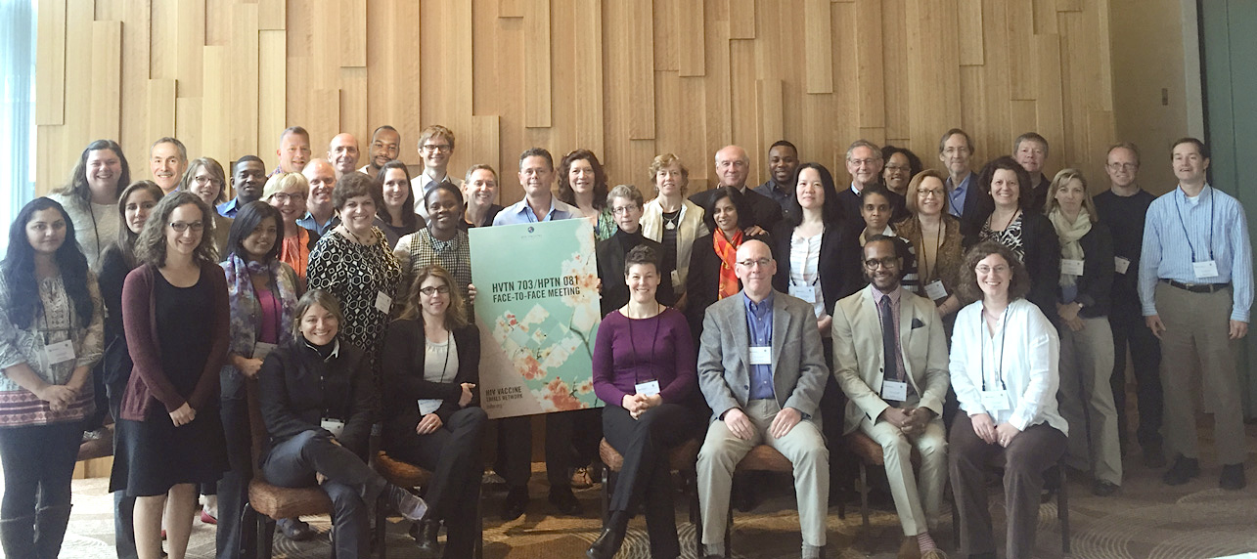
HVTN 703/HPTN 081 Protocol Team Face-to-Face Meeting, May 2015

